Slide 1
Fetching cryptocurrencies market prices from the Coinmarketcap API
Notes:
[Mandatory Slide] This would be the introduction slide of the topic that you are covering in this subsection.
When this slide plays, you could talk about the main aim that we’d be covering in this video.

Slide 2
In this Video, we are going to take a look at…
What you need to know in order to use an API
The Coinmarketcap API
Code: retrieving current Litecoin price from the Coinmarketcap API
Notes:
[Mandatory Slide]
Before the start of the video, we’d like to highlight what are important topics or pointers that we’d be covering in this video. This slide would immediately follow the intro/name slide. This would just be say 2-3 points for the viewers to know what they are getting into.

Slide 3
What you need to know in order to use an API
In order to proficiently use a REST API, this is what you need:
docs about API interface: description of endpoints and supported methods, allowed headers, request body fields, query parameters, etc.
docs about supported data formats both in requests and responses
docs about what errors can be returned
authentication info: if and what credentials are needed (eg. API key)
info about API call limitations over time (if any)
examples of API calls
It is also good to know if any API client SDKs exist
Notes:
[Mandatory Slide]
Before the start of the video, we’d like to highlight what are important topics or pointers that we’d be covering in this video. This slide would immediately follow the intro/name slide. This would just be say 2-3 points for the viewers to know what they are getting into.

Slide 4
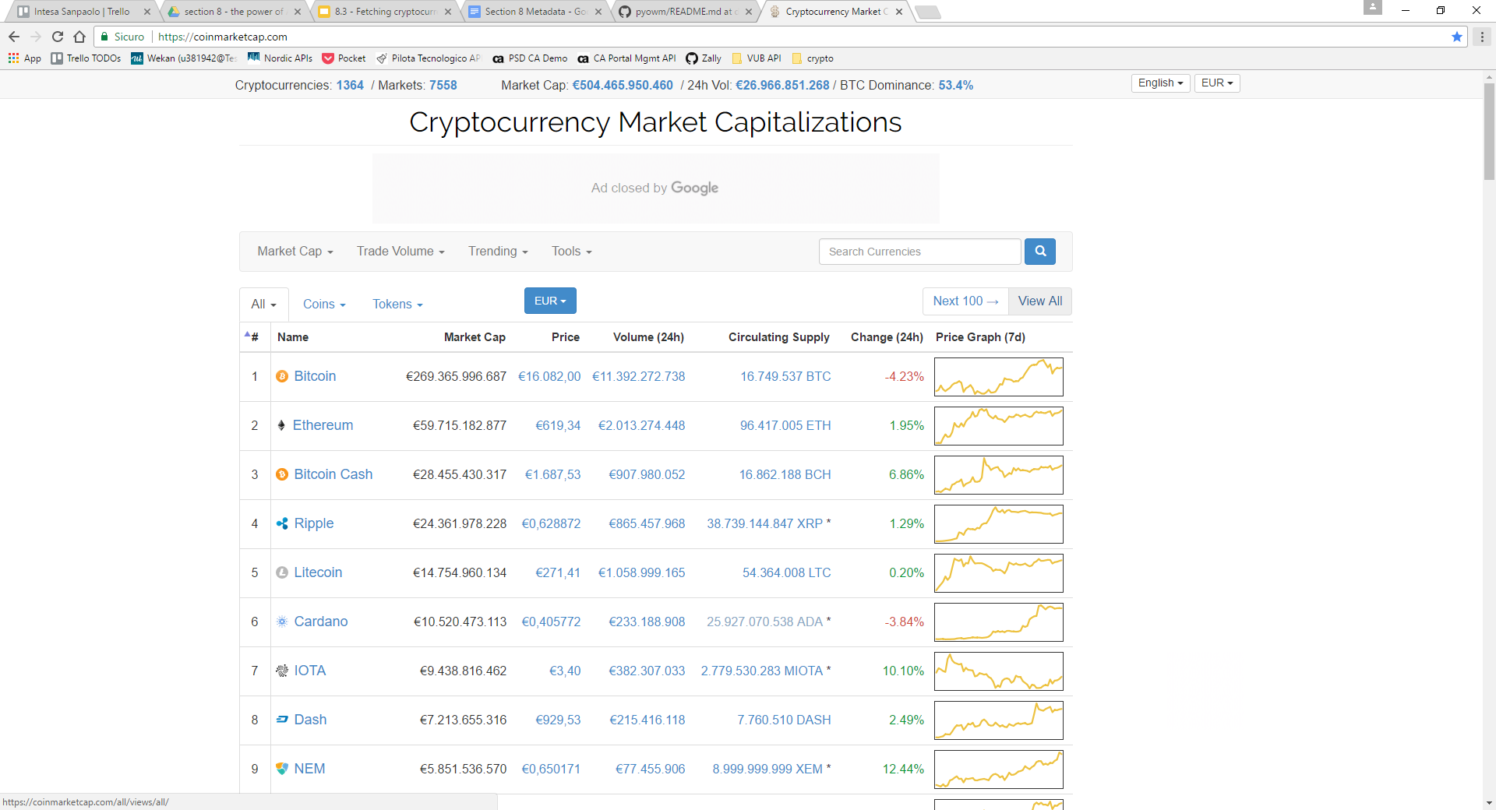
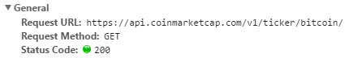
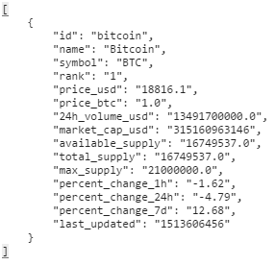
The Coinmarketcap API
Coinmarketcap is a free cryptocurrency information service featuring a website and a public REST API
API Documentation is available at https://coinmarketcap.com/api/ and contains
List of endpoints and relative invocation methods
Endpoint invocation examples
Sample JSON responses (also error responses)
API usage limitations
Eg. say that we want to retrieve current Bitcoin’s information. The docs says that the endpoint to be invoked is: /ticker/bitcoin in GET
Notes:
[Mandatory Slide]
Before the start of the video, we’d like to highlight what are important topics or pointers that we’d be covering in this video. This slide would immediately follow the intro/name slide. This would just be say 2-3 points for the viewers to know what they are getting into.

Slide 5
Code: retrieving current Litecoin price from the Coinmarketcap API
Notes:
Something that needs to grab the viewers attention!!

Slide 6
Summary
What you need to know in order to use an API
The Coinmarketcap API
Code: retrieving current Litecoin price from the Coinmarketcap API
Notes:
[Mandatory Slide]
Before the start of the video, we’d like to highlight what are important topics or pointers that we’d be covering in this video. This slide would immediately follow the intro/name slide. This would just be say 2-3 points for the viewers to know what they are getting into.

Slide 7
Retrieving weather forecasts from the OpenWeatherMap API with PyOWM client
Next Video
Notes:
[Mandatory Slide]
Here the name of the next video needs to be mentioned. The narration as you guessed it would be just letting the viewer know exactly where we are at and what we’d be taking over next! ☺

